Slide 1
Counting and recognizing non-moving objects by means of image processing
ESAT 1A1
Co-titular: Tinne Tuytelaars
Coaches: Xuanli Chen & José Oramas
Realised by: Max Beerten, Brent De Bleser, Wouter Devos,
Ben Fidlers, Simon Gulix, Tom Kerkhofs

Slide 2
Table of contents
Introduction
Problem description
Hardware
Software
Depth
Overlap
Colour
Application
Flaws
GUI
Conclusion

Slide 3
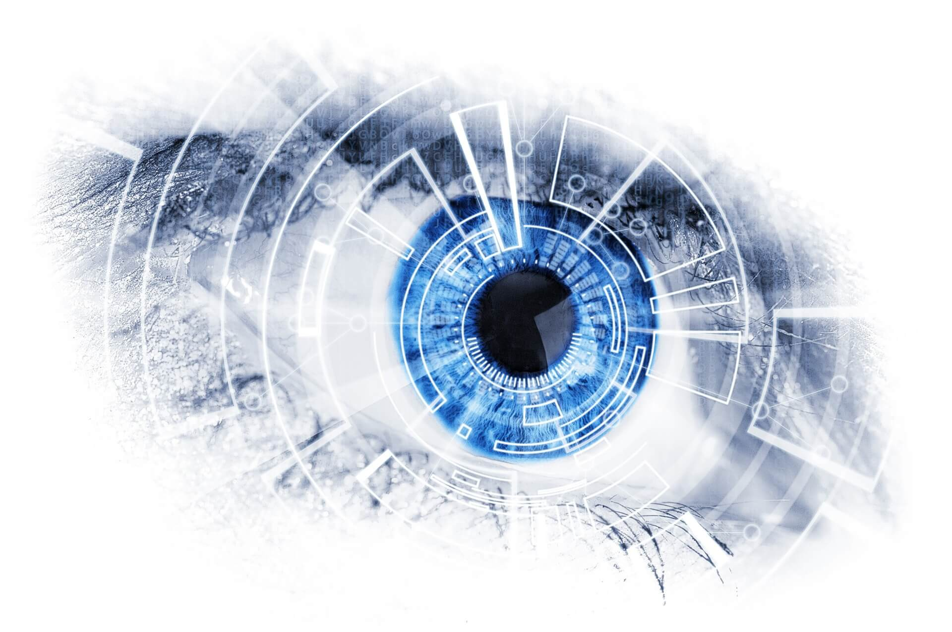
1. Introduction
Object counting using image processing
AI and machine learning
PSI at ESAT
Retrieved from DevisionX ¹
¹ Why you should integrate machine vision in your production process? (02/02/18). Retrieved (22/11/2018), from https://devisionx.com

Slide 4
Table of contents
Introduction
Problem description
Hardware
Software
Depth
Overlap
Colour
Application
Flaws
GUI
Conclusion

Slide 5
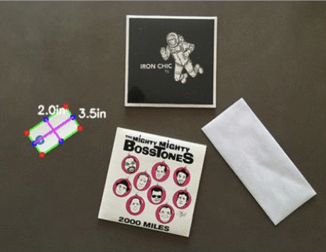
2. Problem description
Visual inspection system
Objects of uniform colour and shape
Camera
Retrieved from Toledo ²
² Opgaveblad P&0 3: Automatisch tellen van voorwerpen in een beeld

Slide 6
Table of contents
Introduction
Problem description
Hardware
Software
Depth
Overlap
Colour
Application
Flaws
GUI
Conclusion

Slide 7
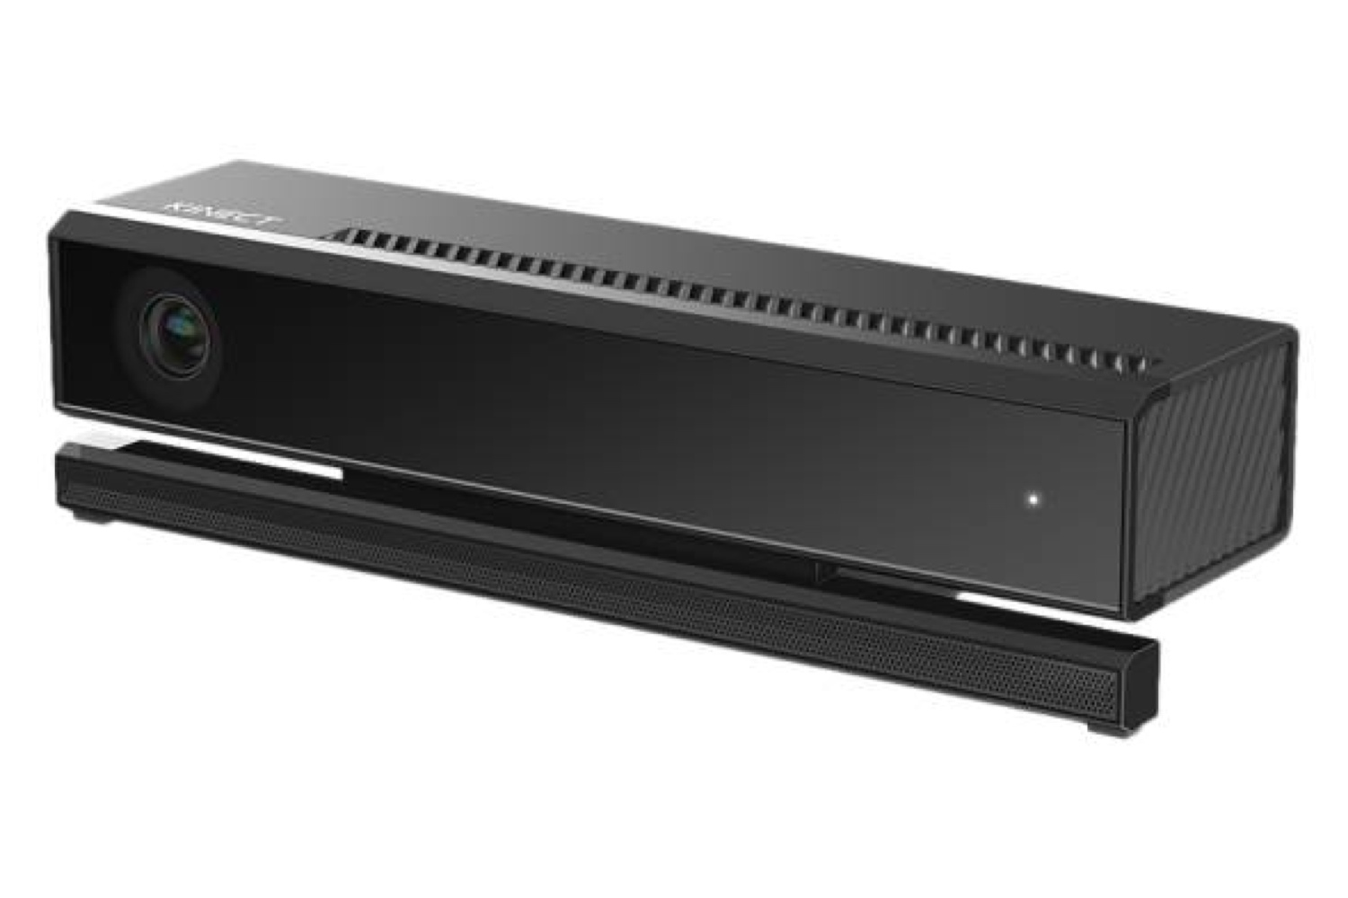
3. Hardware
Hardware components:
Camera
Transfer cable
PC
Box
Retrieved from Time ³
FOTO BOX
³ Why you should integrate machine vision in your production process? (07/07/14). Retrieved (14/12/2018), from http://time.com/2962269/kinect-v2-0-for-windows/

Slide 8
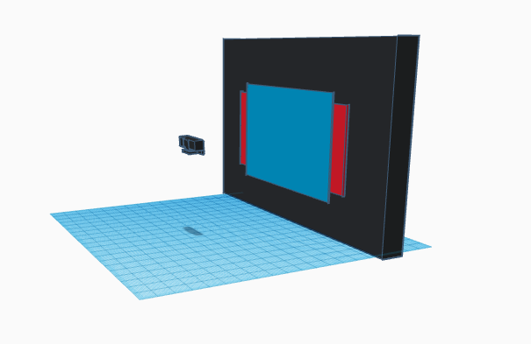
3. Hardware
Kinect v2
Colour and depth sensor
Different field of views
Matrix representation

Slide 9
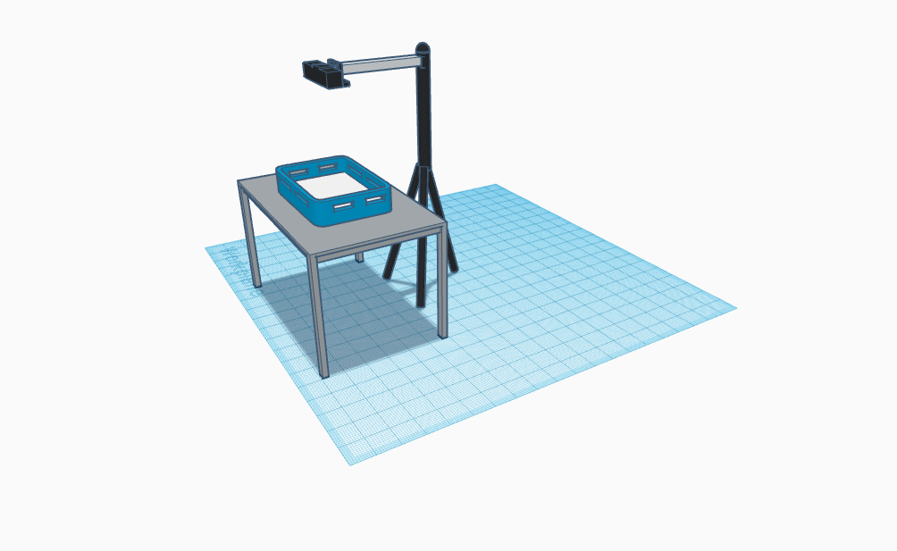
3. Hardware
Visual setup:
Height
Angle
Lighting

Slide 10
Table of contents
Introduction
Problem description
Hardware
Software
Depth
Overlap
Colour
Application
Flaws
GUI
Conclusion

Slide 11
4. Samenvatting software

Slide 12
Table of contents
Introduction
Problem description
Hardware
Software
Depth
Overlap
Colour
Application
Flaws
GUI
Conclusion

Slide 13
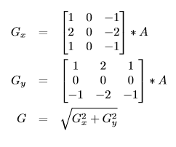
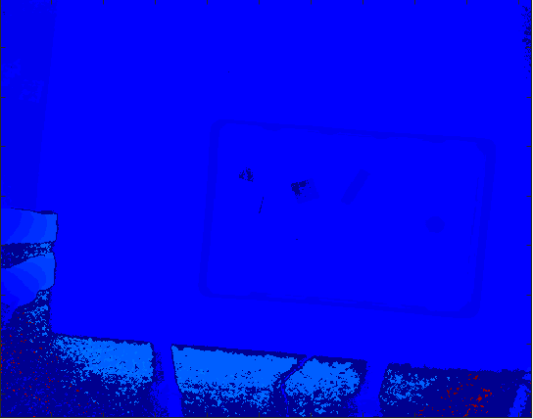
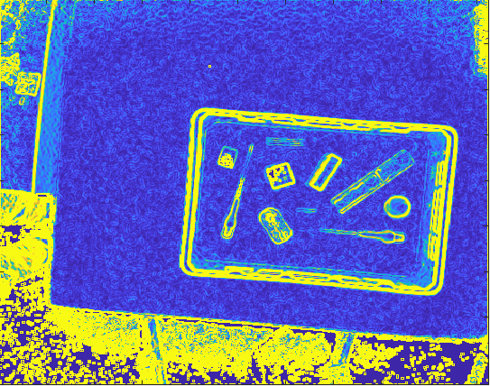
4a. Depth
Step 1: Detection of the difference in height
Sobel-Feldman operator
≈ Gradient vector
Convolving kernel with depth matrix

Slide 14
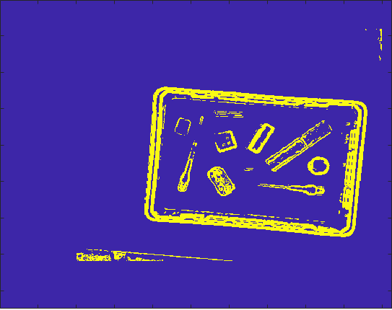
4a. Depth
Step 2: Filtering of the noise
Delete noise + impossible elements
a < x < A; b < y < B; c < value < C
c = 30; C = 500
Result = binary matrix

Slide 15
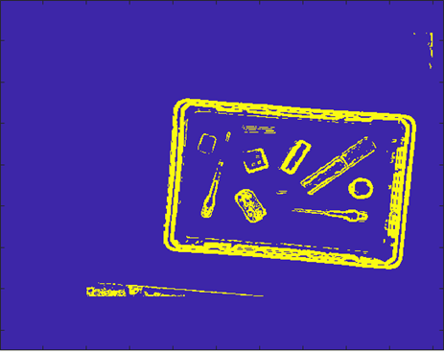
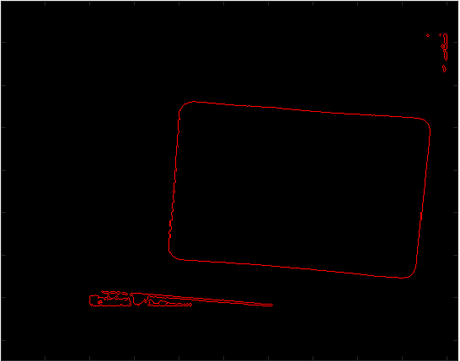
4a. Depth
Step 3: Find the outer edge
Function runs from top left to bottom right
Value == 0?
No edge
Next position
Value == 1?
Edge
Surround object with ‘-1’
Value == -1?
Already surrounded
Skip to next -1

Slide 16
Table of contents
Introduction
Problem description
Hardware
Software
Depth
Overlap
Colour
Application
Flaws
GUI
Conclusion

Slide 17
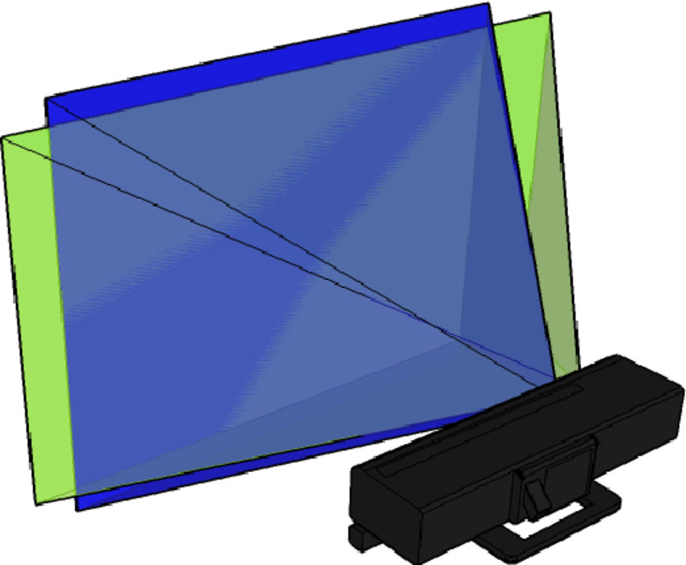
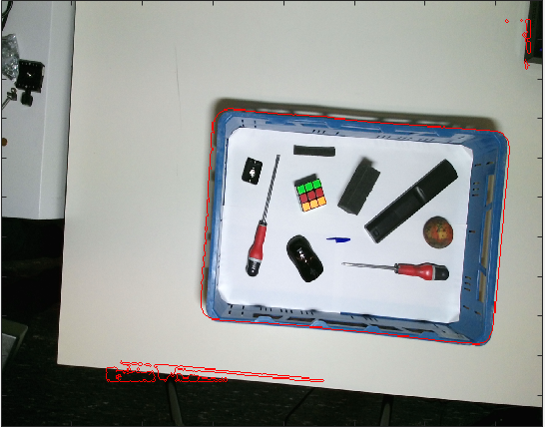
4b. Overlap
Step 1: Combine Depth and RGB
Crop height Depth and width RGB
Find proportion pixels (1x1 ≈ 3x3)
Map Depth to RGB
Retrieved from Researchgate ¹
¹ Calibration of Kinect for Xbox One and Comparison between the Two Generations of Microsoft Sensors, Diana Pagliari (01/10/2015), Retrieved 16/12/2018 from www.researchgate.net

Slide 18
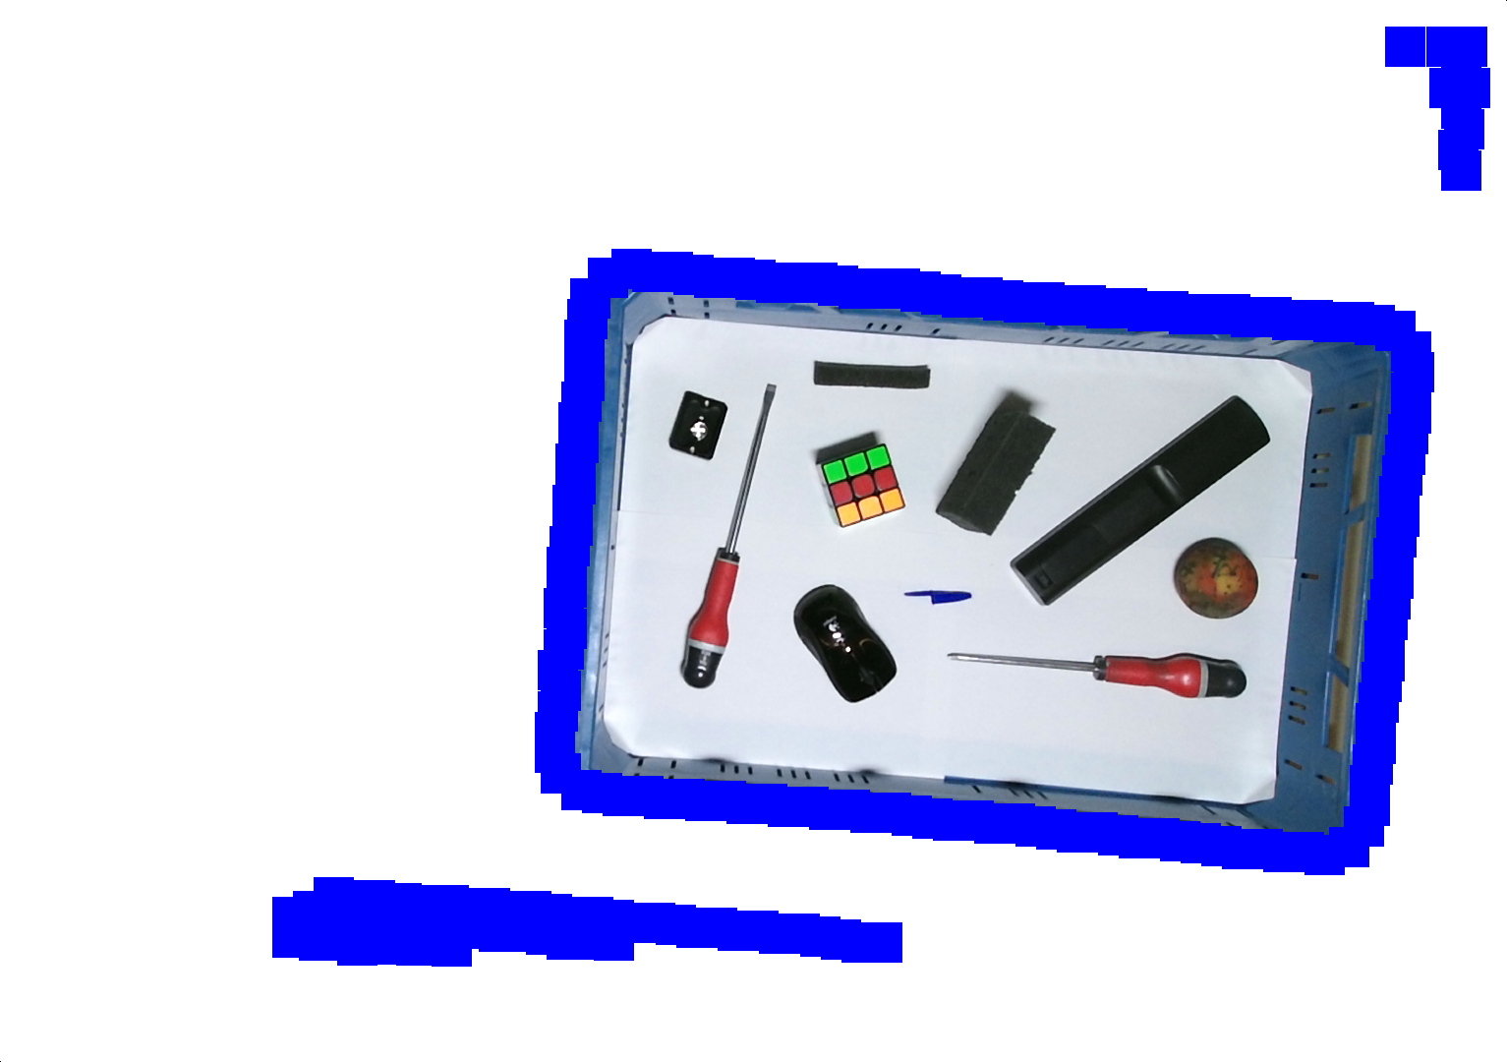
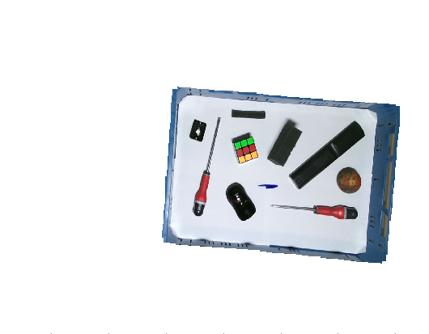
4b. Overlap
Step 2: Crop the matrix to the basket
Create thicker edge
Run through matrix in 4 directions
Value = (0;0;0) until value == (0;0;255)
Clears small imperfections

Slide 19
Table of contents
Introduction
Problem description
Hardware
Software
Depth
Overlap
Colour
Application
Flaws
GUI
Conclusion

Slide 20
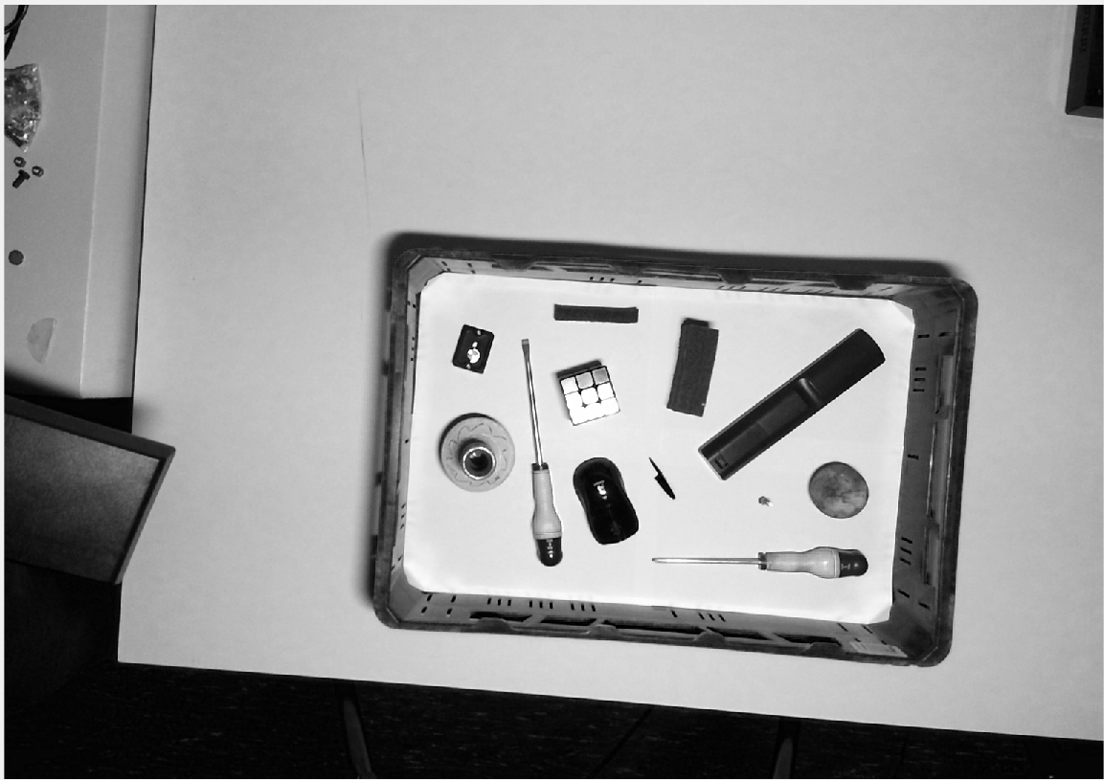
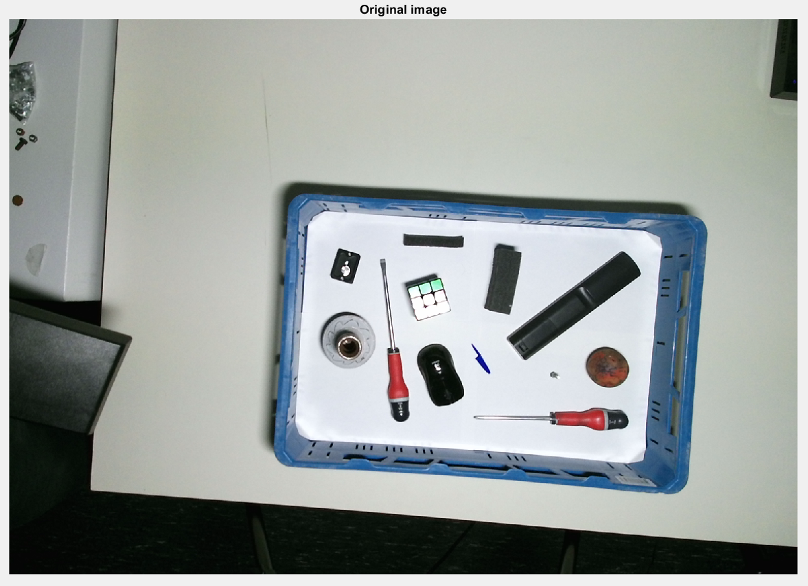
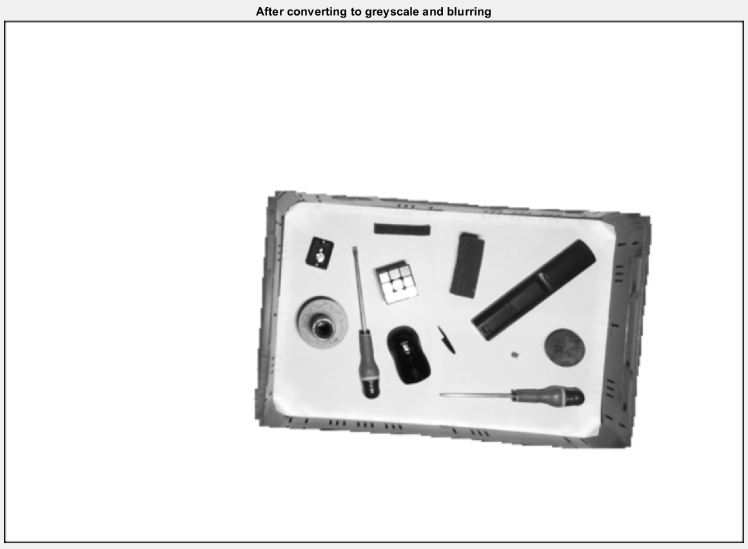
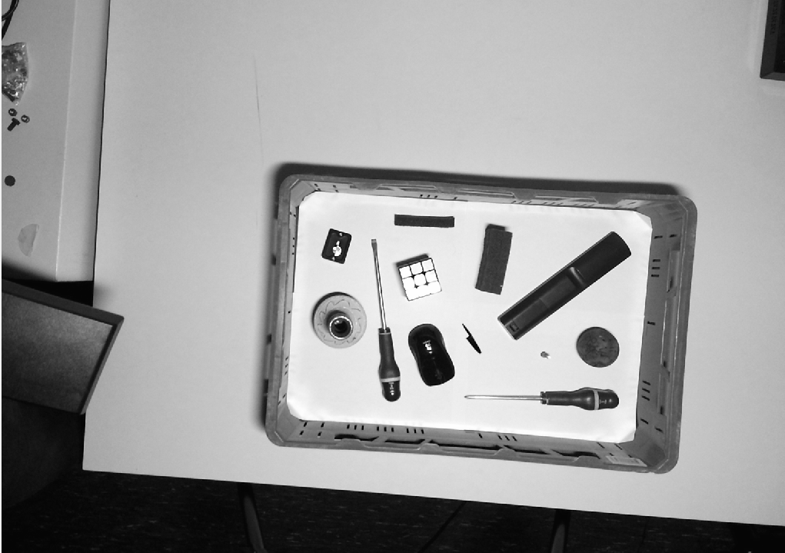
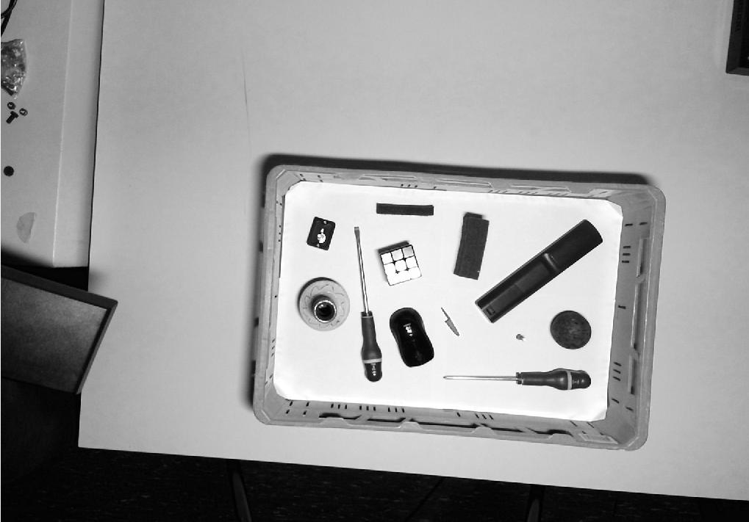
4c. Colour
Red
Step 1: Converting to greyscale
0.2989*
Green
0.5870*
0.1140*
Blue
* Those coëfficiënts come from: https://nl.mathworks.com/help/matlab/ref/rgb2gray.html#buiz8mj-9

Slide 21
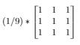
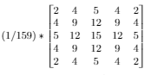
4c: Colour
Step 2: Blurring
Mean blur
Gaussian blur
Mean kernel
Gaussian kernel
*
*

Slide 22
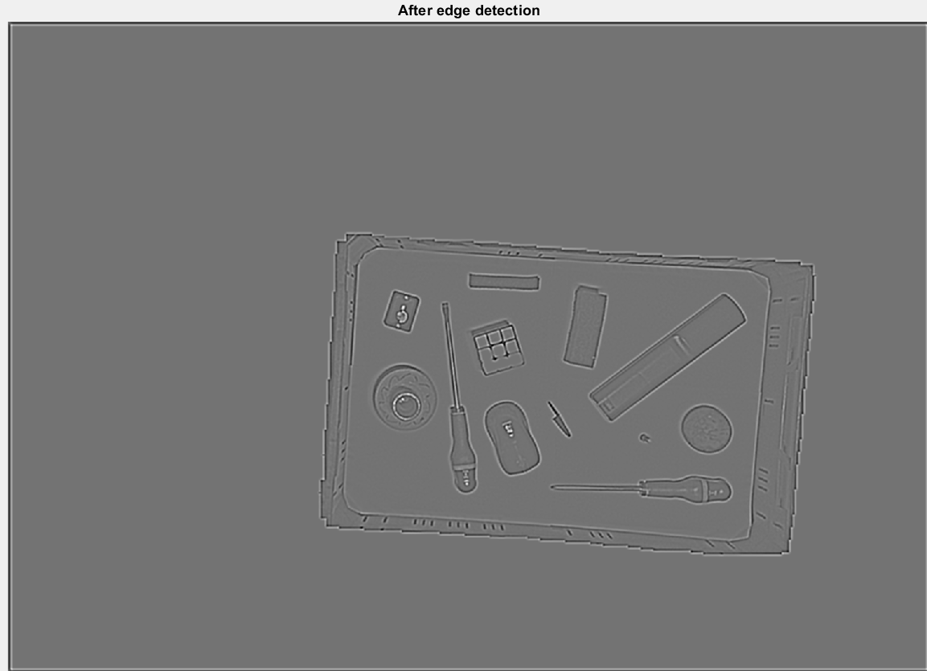
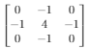
4c. Colour
Step 3: Edge detection
*
=

Slide 23
4c: Colour
Problem with convolutions
1
1
1
1
1
1
1
1
1
1 1
1 1 1 1 1 1 1 1 1 1 1 1
Remove_boundary()

Slide 24
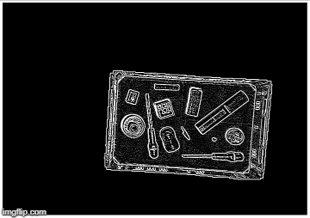
4c: Colour
Step 4: Thresholding
Notice the white border

Slide 25

4c: Colour
Step 5: Grouping

Slide 26
Problem regroup

Slide 27
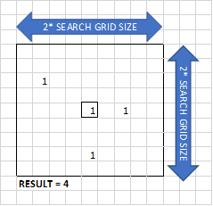
4c: Colour
Step 6: Grouping
Loop through every pixel:
Check if pixel is black
Count same pixels values in grid
Check if that amount of pixels is big enough
Search for group number in grid (No group found? -> assign new group number)
Place group number in matrix

Slide 28
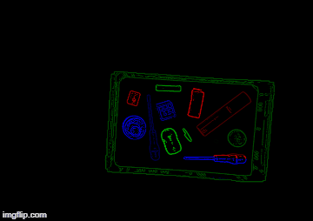
4c: Colour
Step 7: Regrouping
Loop through every pixel (right-top to left-bottom)
Check if group number is not 0.
Check if there is another group in the X-pixels below this pixel.
Replace group number of the bottom group with the top group number.

Slide 29
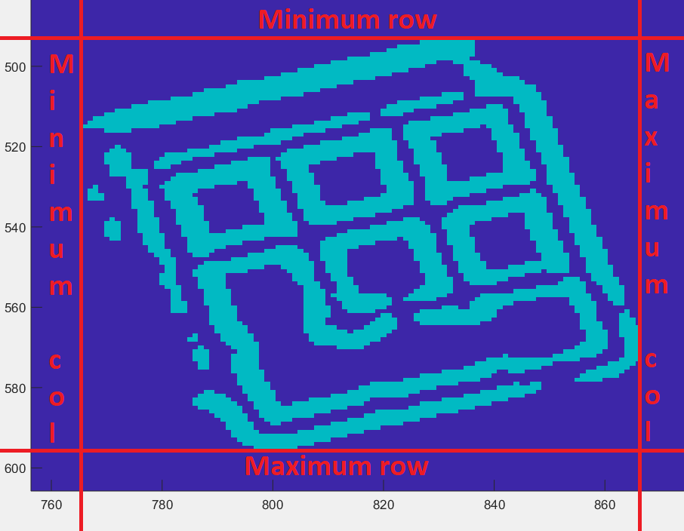
4c: Colour
Step 7: Drawing boundary boxes

Slide 30
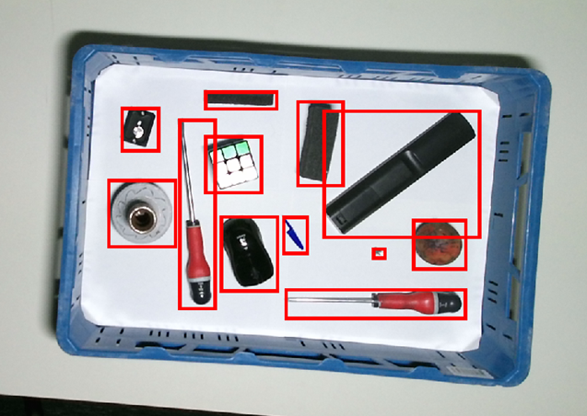
4c. Colour

Slide 31
Table of contents
Introduction
Problem description
Hardware
Software
Depth
Overlap
Colour
Application
Flaws
GUI
Conclusion

Slide 32
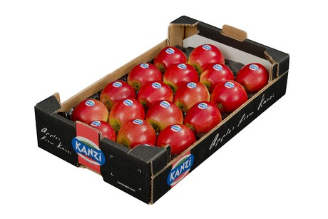
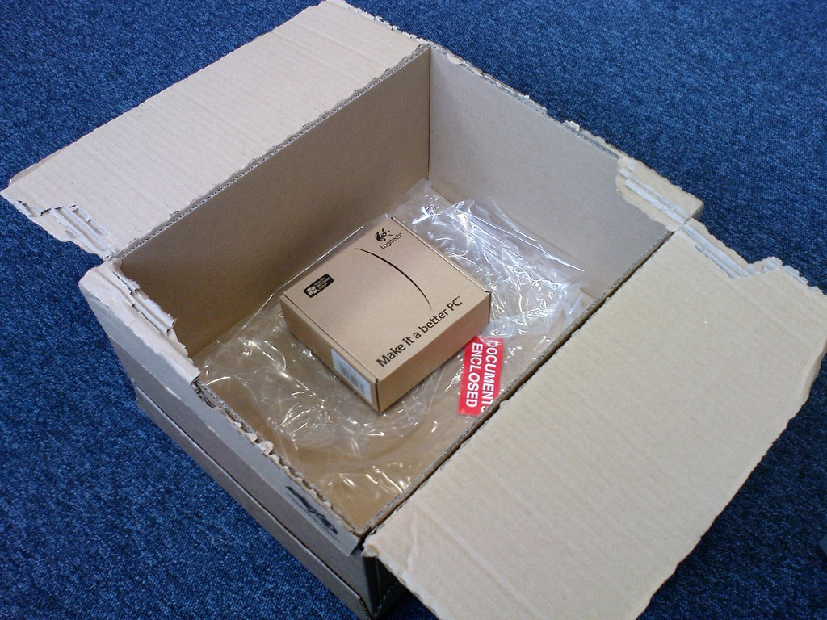
5. Application
General:
Engineering project
Counting uniform objects
Optimal object packaging
Retrieved from Freshplaza ⁴
Solving the Box Selection Algorithm
Retrieved from Medium ⁵
⁴ Preis für Kanzi erzielt Rekordhöhe (06/03/18). Retrieved (15/12/2018), from https://www.freshplaza.de/artikel/5015819/preis-fuer-kanzi-erzielt-rekordhoehe/
⁵ Solving the Box Selection Algorithm (01/07/16). Retrieved (14/12/2018), from https://medium.com/the-chain/solving-the-box-selection-algorithm-8695df087a4

Slide 33
5. Application
Approach
Starting where we left off
Cut objects out of image
Sort them from large to small
Fill the given basket as efficient as possible

Slide 34
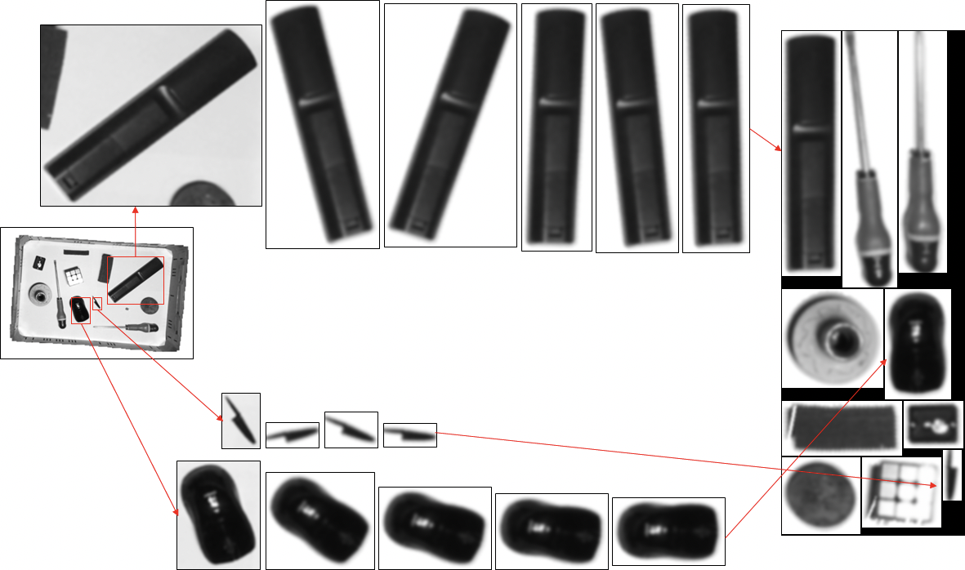
5. Application
Step 1:
Gathering all objects
Non-optimal packaging
Elements get whitened
Insertion sort

Slide 35
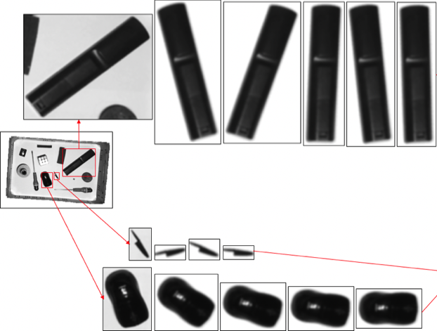
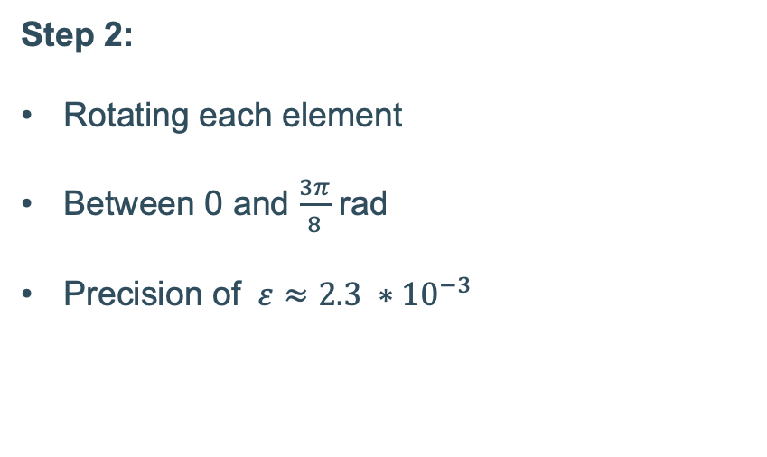
5. Application
Step 2:
Rotating each element
Between 0 and $\frac{3π}{8}$ rad
Precision of $ε≈2.3 ∗{10}^{−3}$

Slide 36
5. Application
Step 3:
Combining all optimal boundary boxes
Greedy algorithm
Normal matrix and its transpose

Slide 37
Table of contents
Introduction
Problem description
Hardware
Software
Depth
Overlap
Colour
Application
Flaws
GUI
Conclusion

Slide 38
6. Flaws

Slide 39
Table of contents
Introduction
Problem description
Hardware
Software
Depth
Overlap
Colour
Application
Flaws
GUI
Conclusion

Slide 40
7. GUI

Slide 41
Table of contents
Introduction
Problem description
Hardware
Software
Depth
Overlap
Colour
Application
Flaws
GUI
Conclusion

Slide 42
8. Conclusion
Depth data
Finding basket
Overlap
Depth and RGB
RGB Image of basket
Finding best package
Boundary boxes
Grouping edges
Finding edges

Slide 43
Questions?
Keep them in mind for a moment. Our colleagues will gladly answer all your questions.

